Slide 1
HOW I SPEND MY WEEKENDS!
By
Katerina Perikleous

Slide 2
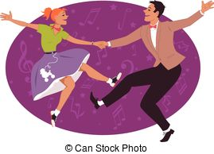
I always go dancing lessons on the weekends.

Slide 3
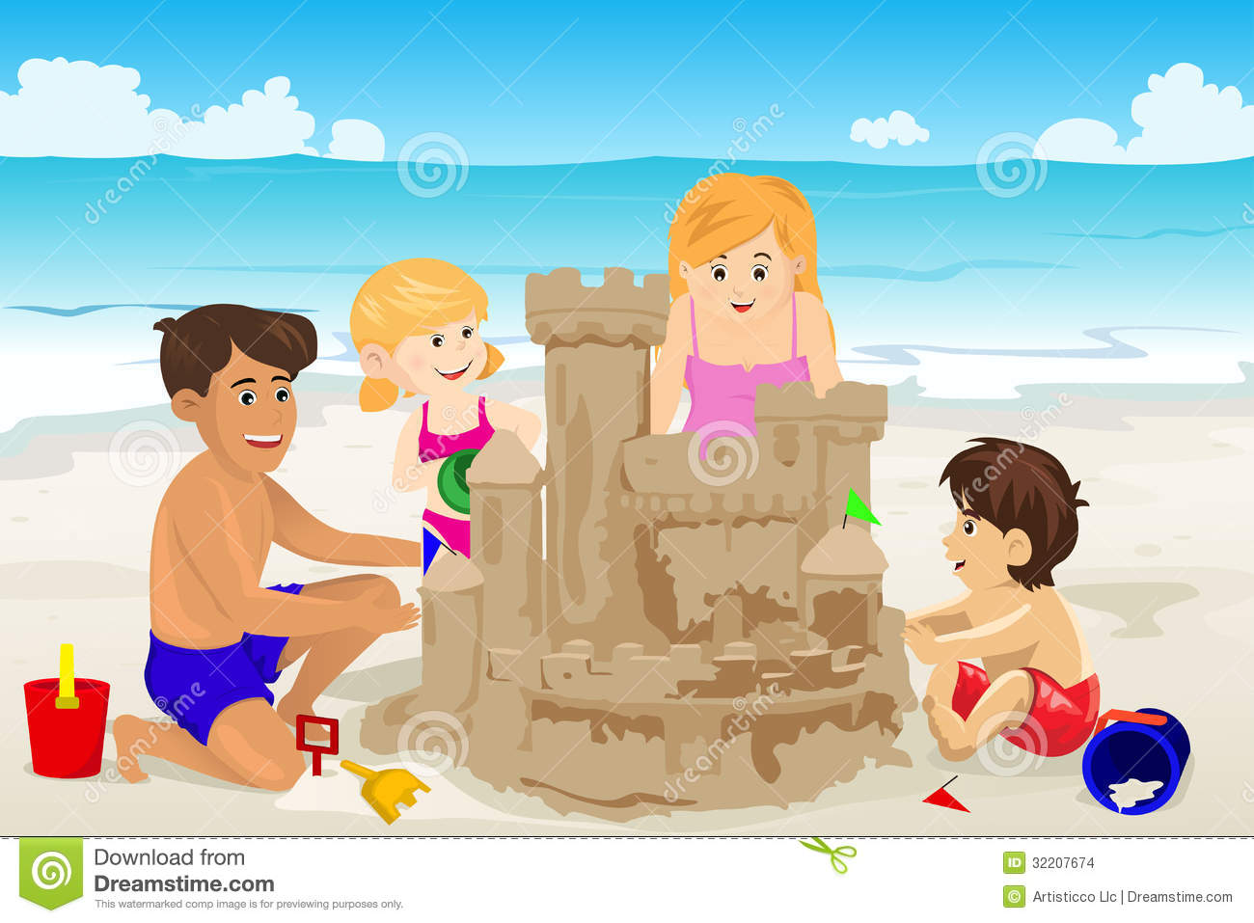
I sometimes go walking at the beach on the weekends.

Slide 4
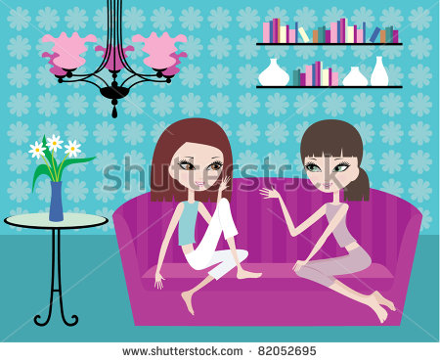
I usually visit my friends.

