Slide 1
How I spend my weekends!
By
Michael Kareklas

Slide 2
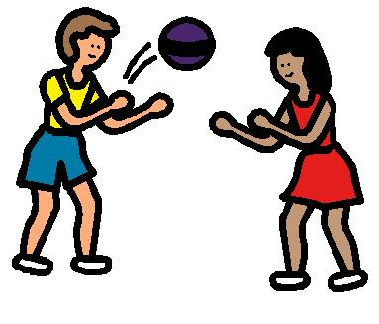
I always go to my uncle’s house and play with my friends!

Slide 3
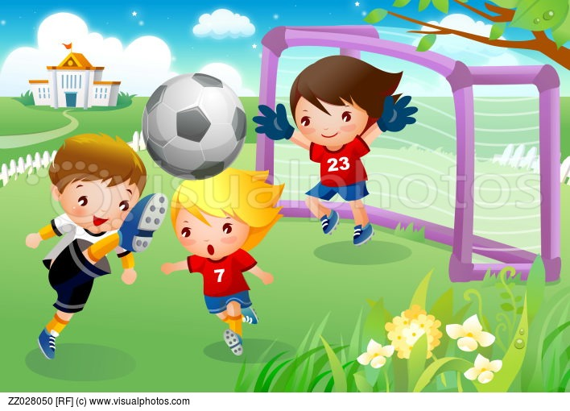
I usually play football with my friends!

Slide 4
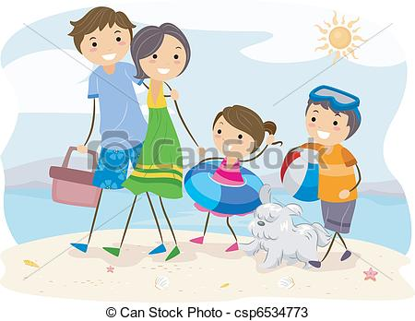
I sometimes go to the beach with my family!

